Slide 1
Open Table
Our Team:
Prince Joy
Vince Joseph
Philip Mathew Kurian
Nikhil Mathew Francis
Our Guide:
Priya S A

Slide 2
Introduction
It’s a fact that food makes people happier. But even though food service systems has grown to a great extend, still users are unable to find many local food spots providing delicious food. Getting low quality food, bad services etc. from top rated restaurants are some of the after effects of paid promotions. In addition, existing systems are going without recognizing small, but good restaurants.
Our goal is to overcome these drawbacks of present conventional food service systems by giving recognition to small restaurants, providing trustable reviews etc.

Slide 3
Proposed Idea
The project intends to build a mobile application which helps users to find the nearest restaurants providing delicious food based on user reviews.
The registered users are allowed to post comments, about food quality, amenities, hygiene, services and short videos about the restaurants
The option to review any restaurant gives recognition to small scale restaurants(like homely food) which provides delicious food at a fair price
The app tries to reduce the overhead of searching for a good restaurant in an enormous number of other social media posts and articles
Also our app can recognize restaurants in places where other delivery services are not yet reached.

Slide 4
Working overview
User can:
Load the map or can search for a place.
Traverse through the list of restaurants and its reviews
Report an in- appropriate review
Add new restaurant to the existing collection of restaurants in that area
Add reviews about a restaurant
Edits previous reviews if he/she wants to.
Save a restaurant for later use

Slide 5
Tech used
Front end: Android studio to develop the app
Back end: Firebase

Slide 6
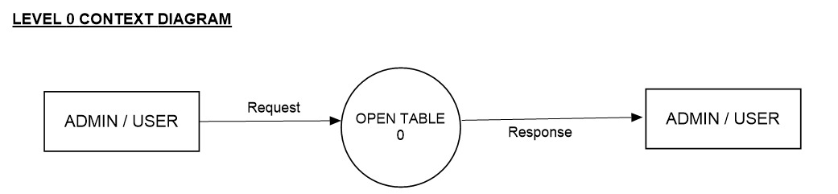
DATA FLOW DIAGRAMS

Slide 7
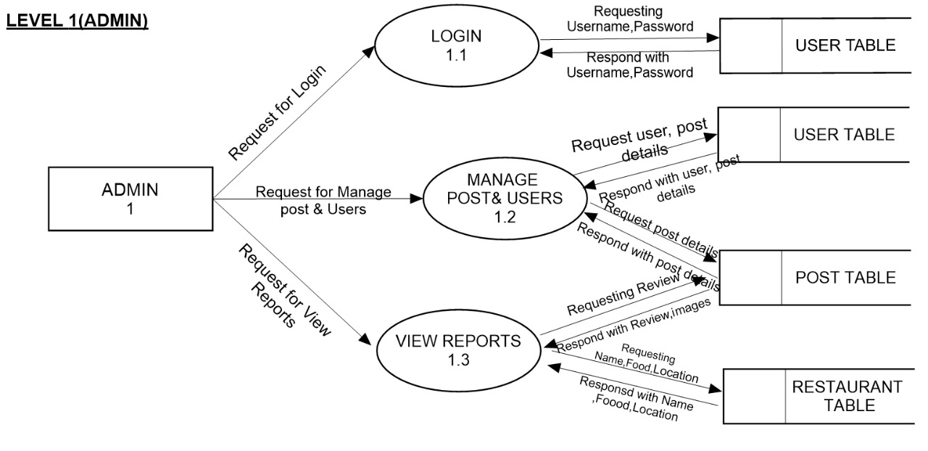

Slide 8
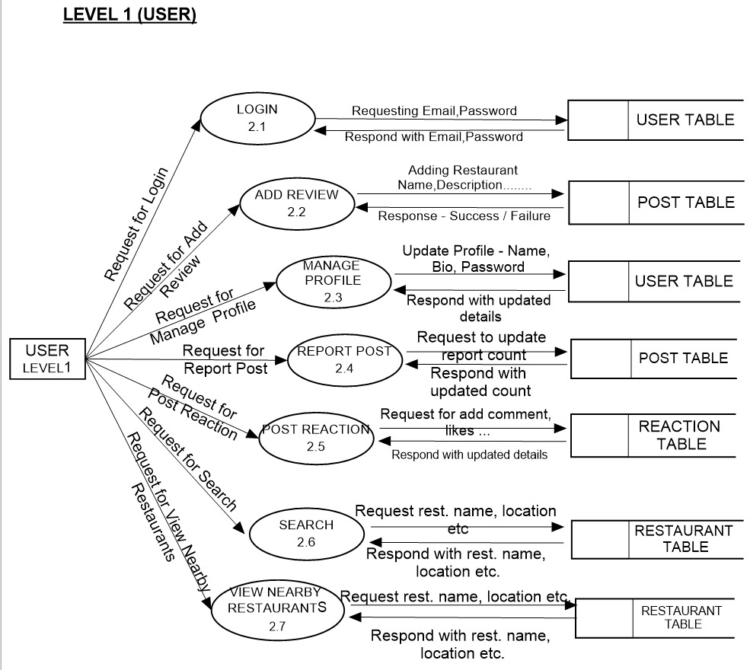

Slide 9
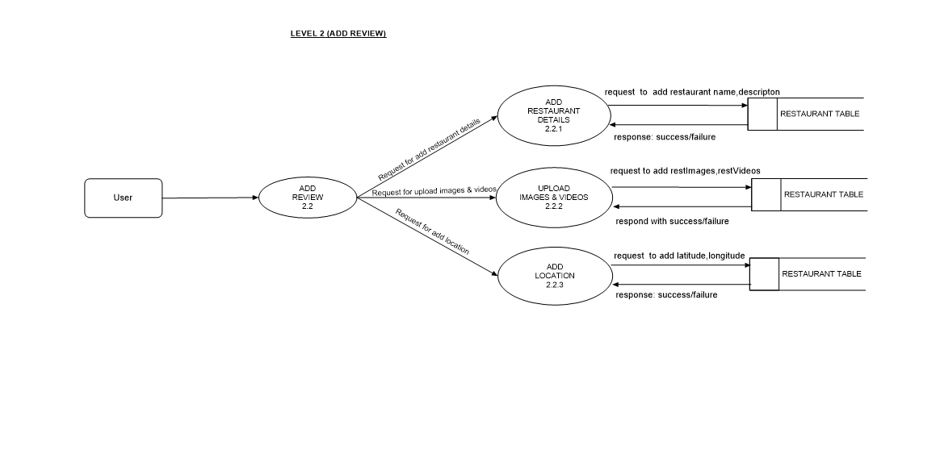

Slide 10
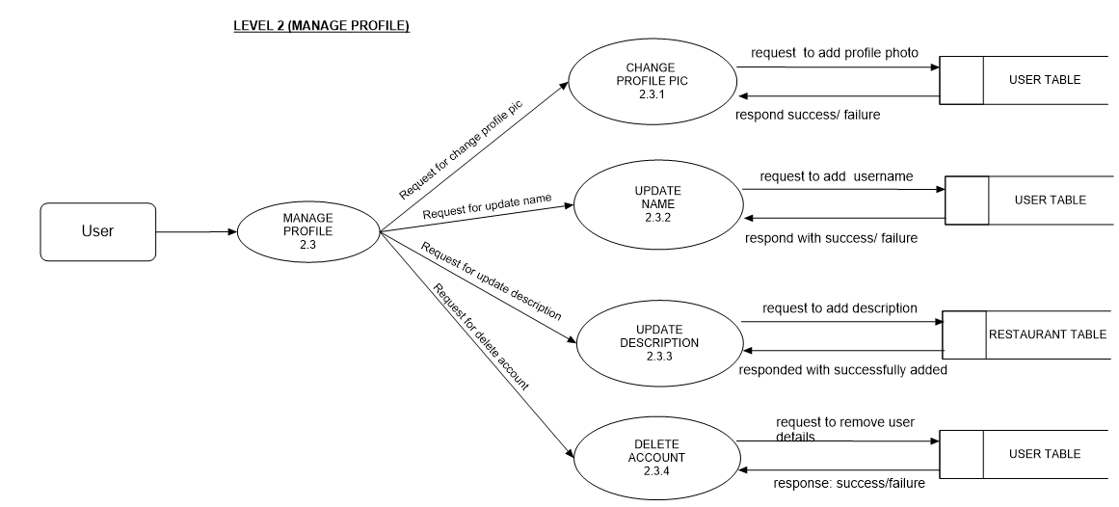

Slide 11
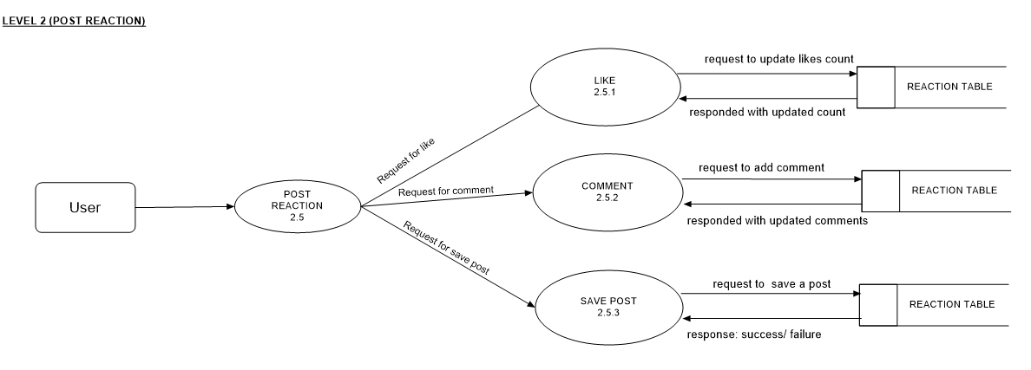

Slide 12
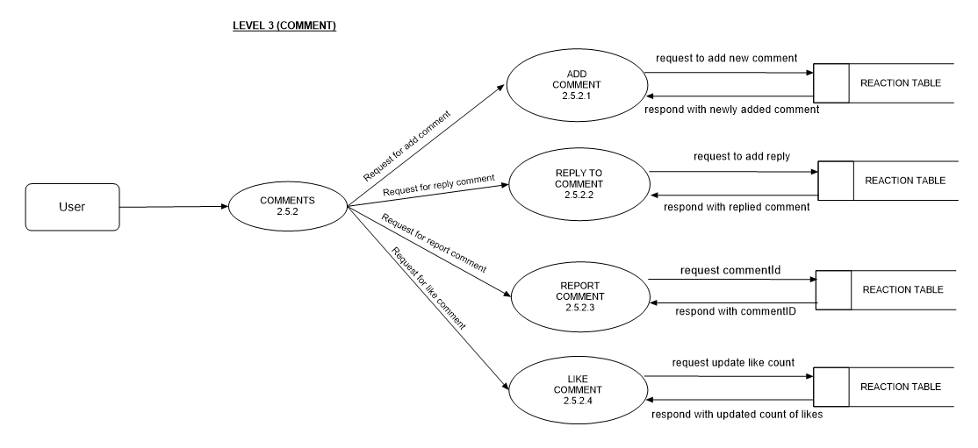

Slide 13
Thank You

